Slide 1
A Simple and Effective Usage of Word Clusters for CBOWModel
A report for Cse431 NLP Individual Assignment 4 by Asef Hassan Amiz
ID 16321088

Slide 2
About
Thesis Research by
Yukun Feng1, Chenlong Hu1, Hidetaka Kamigaito1, Hiroya Takamura1;2 and Manabu Okumura
From Tokyo Institute of Technology
National Institute of Advanced Industrial Science and Technology (AIST)
Simple and Effective Usage of Word Clusters for Continuous Bag of word Model

Slide 3

Abstract
A simple and effective method for incorporating word clusters into the Continuous Bag-of-Words (CBOW) model
Using replacing methods which work well on several downstream tasks.

Slide 4
Introduction
Word embeddings for NLP
Replacing Methods
Word embeddings can be pre trained on a large corpus
One of the most well-known methods for obtaining word embeddings is based on Continuous Bag-of-Words (CBOW)
Replace the Infrequent words with their clusters for both input and output words in the CBOW model
Then Fine Tuning the cluster-incorporated word embeddings for downstream tasks

Slide 5
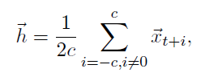
The Continuous Bag of Word Model
Let wt Denote the t-th word in a Text. The CBOW model predicts the output word wt given the input words in the window which precede or follow the output word. The CBOW model computes the hidden representation “h” by this expression where c is window size

Slide 6
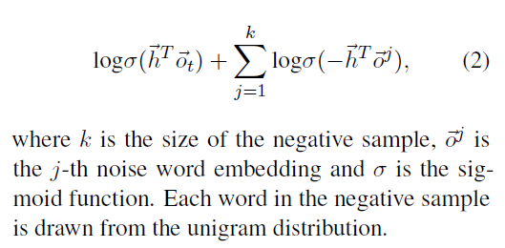
The Objective Function

Slide 7
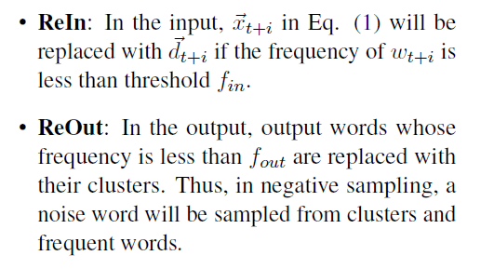
The Replacing Methods

Slide 8
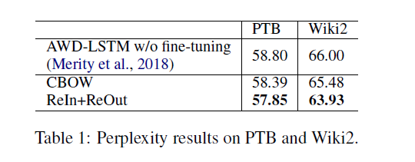
Experiments on Language Model & Machine Translation
The CBOW and ReIn+ReOut indicate that they are initialization methods for specific downstream tasks.

Slide 9
Hyper Parameter Settings for the conducted experiments
Number of word clusters - 600
Training epoch - 5
Number of Negative Samples - 5
Window Size -5
Minimum count of word occurrence - 5

Slide 10
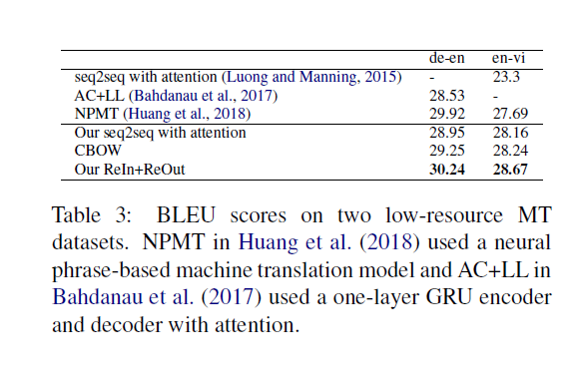
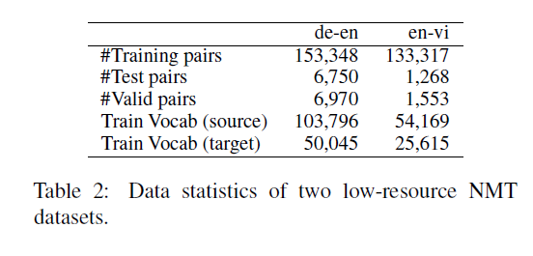
Experiments on Language Model
Without any extra language pair resources, the ReIn+ReOut initialization improves the BLEU score over the baseline by 1.29 and 0.51 points on de-en, en-vi respectively
Standard long-short term memory networks (LSTMs) based sequence to sequence model on two datasets: German-English (de-en) & English-Vietnamese (en-vi)

Slide 11
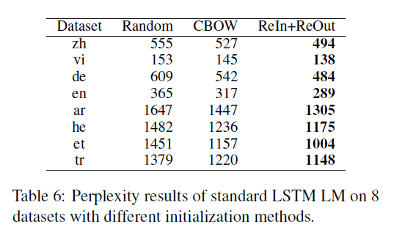
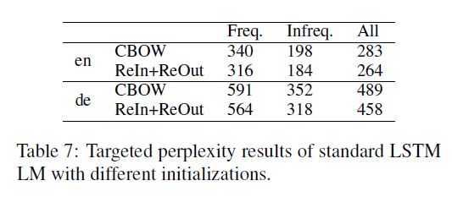
Analysis
Targeted Perplexity Results

Slide 12
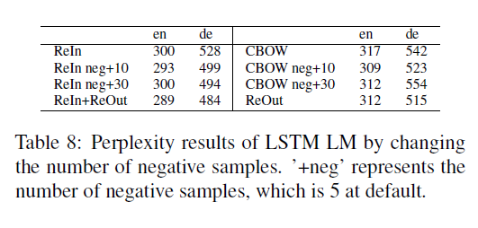
Analysis
Ablation Study
Comparing the methods ReIn and CBOW, they found replacing only input infrequent words in CBOW also works better than the original CBOW

Slide 13
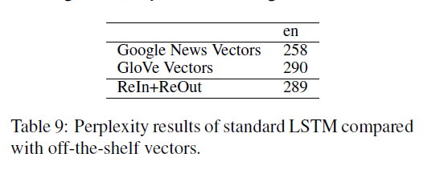
Analysis
LM Results on Off-the-shelf Vectors
To gauge the improvements They used off-the-shelf pre trained word vectors in English: GloVe vectors and Google News Vectors

Slide 14
Conclusion
They proposed a simple and effective method to incorporate word clusters into the CBOW model. Their method is effective on several downstream tasks. For future work they planned on testing their methods on larger corpora add more downstream tasks.

Slide 15
References
Thang Luong, Richard Socher, and Christopher Manning. 2013. Better word representations with recursive neural networks for morphology. In Proceedings of the Seventeenth Conference on Computational Natural Language Learning, pages 104–113. Stephen Merity, Nitish Shirish Keskar, and Richard Socher. 2018. Regularizing and optimizing lstm language models. In International Conference on Learning Representations.
Tomas Mikolov, Kai Chen, Greg Corrado, and Jeffrey Dean. 2013a. Efficient estimation of word representations in vector space. arXiv preprint arXiv:1301.3781.
Tomas Mikolov, Ilya Sutskever, Kai Chen, Greg S Corrado, and Jeff Dean. 2013b. Distributed representations of words and phrases and their compositionality. In Advances in neural information processing systems, pages 3111–3119. Arvind Neelakantan, Jeevan Shankar, Alexandre Passos, and Andrew McCallum. 2014. Efficient nonparametric estimation of multiple embeddings per word in vector space. In EMNLP.
Jeffrey Pennington, Richard Socher, and Christopher D. Manning. 2014. Glove: Global vectors for word representation. In Empirical Methods in Natural Language Processing (EMNLP), pages 1532–1543. Siyu Qiu, Qing Cui, Jiang Bian, Bin Gao, and Tie-Yan
Liu. 2014. Co-learning of word representations and morpheme representations. In Proceedings of COLING 2014, the 25th International Conference on Computational Linguistics: Technical Papers, pages 141–150. Alan Ritter, Sam Clark, Oren Etzioni, et al. 2011. Named entity recognition in tweets: an experimental study. In Proceedings of the conference on empirical methods in natural language processing, pages 1524–1534. Association for Computational Linguistics.
Raphael Shu and Hideki Nakayama. 2018. Compressing word embeddings via deep compositional code learning. In International Conference on Learning Representations.
Dzmitry Bahdanau, Philemon Brakel, Kelvin Xu, Anirudh Goyal, Ryan Lowe, Joelle Pineau, Aaron C. Courville, and Yoshua Bengio. 2017. An actor-critic algorithm for sequence prediction. In International Conference on Learning Representations.
Piotr Bojanowski, Edouard Grave, Armand Joulin, and Tomas Mikolov. 2017. Enriching word vectors with subword information. Transactions of the Association for Computational Linguistics, 5:135–146.
Jan A. Botha, Emily Pitler, Ji Ma, Anton Bakalov, Alex Salcianu, DavidWeiss, Ryan T. McDonald, and Slav Petrov. 2017. Natural language processing with small feed-forward networks. In EMNLP.
Mauro Cettolo, Christian Girardi, and Marcello Federico. 2012. Wit3: Web inventory of transcribed and translated talks. In Proceedings of the 16th Conference of the European Association for Machine Translation (EAMT), pages 261–268, Trento, Italy.
Mauro Cettolo, Jan Niehues, Sebastian St¨uker, Luisa Bentivogli, and Marcello Federico. 2014. Report on the 11th iwslt evaluation campaign, iwslt 2014. In Proceedings of the International Workshop on Spoken Language Translation, Hanoi, Vietnam
Xinxiong Chen, Lei Xu, Zhiyuan Liu, Maosong Sun, and Huanbo Luan. 2015. Joint learning of character and word embeddings. In Twenty-Fourth International Joint Conference on Artficial Intelligence.
JonDehdari, Liling Tan, and Josef van Genabith. 2016. BI A: Improved predictive exchange word clustering. In Proceedings of the 2016 Conference of the North American Chapter of the Association for Computational Linguistics: Human Language Technologies (NAACL), pages 1169–1174, San Diego, CA, USA. Association for Computational Linguistics.
Daniela Gerz, Ivan Vuli´c, Edoardo Ponti, Jason Naradowsky, Roi Reichart, and Anna Korhonen. 2018. Language modeling for morphologically rich languages: Character-aware modeling for word-level prediction. Transactions of the Association of Computational Linguistics, 6:451–465.

Slide 16
